Slide 1


Emerging
Technology
SIG

Slide 2

Initial Technologies
Emerging
Technology
SIG
2. Process
3. Support
1. Vision
1. Vision

Slide 3
2. Process
3. Support
Initial Technologies
1. Vision

Slide 4
Initial Technologies
Artificial Intelligence
Blockchain & DLT
IOT
Robotics & RPA
Spatial Computing
Quantum Technology
Neural Links
Space Technology
1. Vision

Slide 5
Initial Technologies
Artificial Intelligence | 4D Printing
Blockchain & DLT | Biotechnology
IOT | 5G & 6G
Robotics & RPA | Graphene
Spatial Computing | Natural Language Processing
Quantum Technology | Advanced Data Processing
Neural Links | Cloud Computing
Space Technology | Crypto Agility
1. Vision
2. Process

Slide 6




2. Process
Initial Technologies
Artificial Intelligence | 4D Printing
Blockchain & DLT | Biotechnology
IOT | 5G & 6G
Robotics & RPA | Graphene
Spatial Computing | Natural Language Processing
Quantum Technology | Advanced Data Processing
Neural Links | Cloud Computing
Space Technology | Crypto Agility
1. Vision
3. Support

Slide 7

Emerging Technology Positioning & Explainers

Slide 8
Primers on fundamentals
Core Points:
Primers
Practical application outlines
Defining a Brain Trust
Showcase of Academia
Emerging Technology Positioning & Explainers

Slide 9
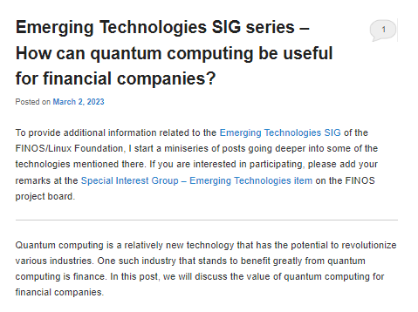
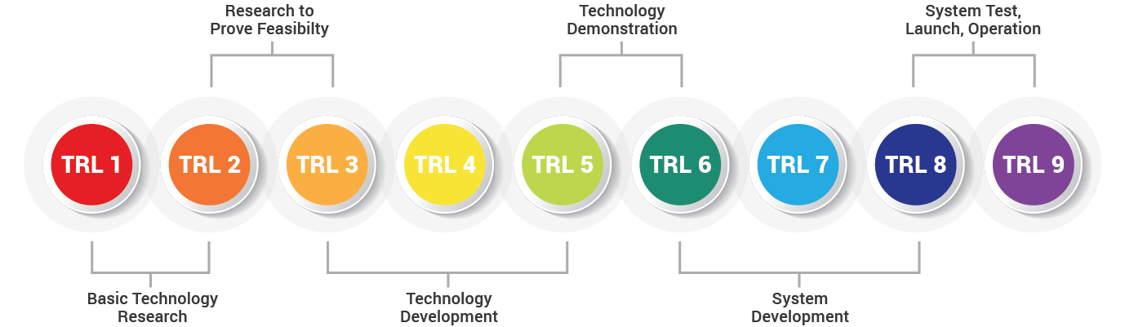
Primers on fundamentals
Created by recognised subject matter experts (SMEs)
Introduction to the subject & relevant reading to seed knowledge
Open comments for further discussion and follow-ups
Details various Technology Readiness Levels of the underlying technology

Slide 10
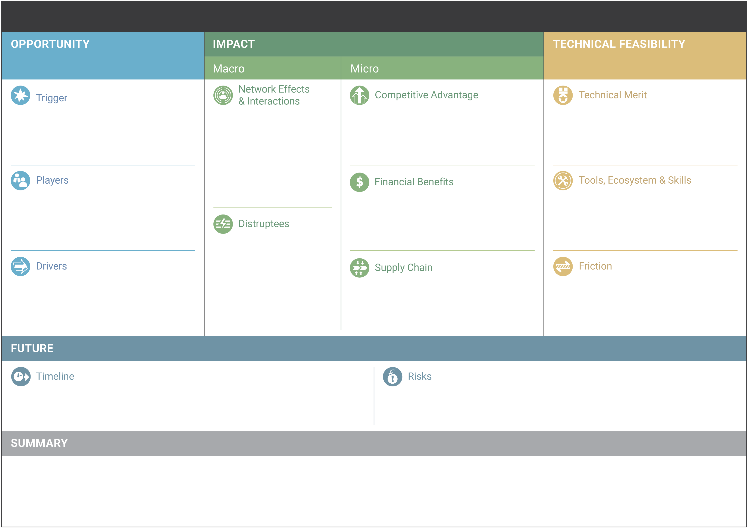
Primers on fundamentals
Outline of practical applications
Emerging Technology Analysis Canvas asset will also be created
Sits alongside the primer in the repository
Aligns to Business Model Canvas
Details can be found at https://github.com/wso2/ETAC

Slide 11
Primers on fundamentals
Outline of practical applications
Brain Trust
Highlight existing efforts to develop & deliver technology solutions
Identify current gaps that need to be explored to seed widespread adoption
Point towards existing efforts to address gaps that remove duplication of effort
Call-to-arms for required exploration

Slide 12





Outline of practical applications
Brain Trust
Identify relevant SMEs who can advise on the applicability or viability of exploration projects
Requires accreditation (awarded by FINOS) that is evaluated under 5 criteria:
Education & Training
Body of Work
Skills & Awards
Professionalism & Ethics
Continual Development

Slide 13


Brain Trust
Showcase of Academic Research
Brain Trust composition will include members from:
Industry / Enterprise
Academia
Entrepreneurs
Legal Professionals
Governance
Theory
Technical
Commercial
Notes:
Creating a diverse landscape of experts will provide reliable context for each discipline

Slide 14
Emerging Technology Positioning & Explainers
Brain Trust
Showcase of Academic Research
Spotlight existing research around the globe
Allow researchers to explain key topics or share insights
Increase collaboration with academic research
Theory
Technical
Commercial

Slide 15

Develop & Curate Open Source Libraries

Slide 16
Creation of standards for quick starting or sandboxing
Attempt to harmonise with existing FINOS initiatives (e.g. Morphir)
Development of Open Source Libraries

Slide 17

General POCs to prove out new technologies

Slide 18

The Process
Exploration program within the SIG aiming to test concepts
Encourages new members to join & participate
Maximum duration and funding limits imposed
Projects subject to a vetting process
General POCs to prove out new technologies

Slide 19

Step 1: Opportunity Outline
Create Primer
Outline where disruption is possible or worth exploring
The Process
Notes:
As part of primer creation, we outline opportunities where the emerging technology can disrupt FinTech, detailing relevant solutions or applications

Slide 20


Step 2: Call for Ideas
From opportunities outlined, define the problem statement
Create a call-to-arms to source proposed solutions
Enable re-use of shelved projects alongside fresh ideas
The Process
Notes:
The Primer raises a call-to-arms for the community to submit ideas or projects to explore within the SIG

Slide 21

Step 3: SME Vetting
Sanity check by the Brain Trust to confirm ideas are:
Possible
Feasible
Worthwhile
Legal
Not already explored
The Process
Notes:
The Brain Trust review the submitted ideas on a regular schedule
If an idea is deemed to have merit for further exploration, the SMEs provide a justification for exploration by the wider SIG

Slide 22

Step 4: Value Proposition
A value proposition is created by the Brain Trust & SIG maintainers
Dependent on available budget & availability of Support Services, priority is given to projects with higher perceived value vs required investment
The Process
Notes:
The maintainers of the SIG work with the Brain Trust to develop a value proposition that explains the predicted impact of the exploration

Slide 23

Step 5: Funding Governance
A pool of representatives from FINOS vote to approve access to exploration funds or resources to facilitate exploration
Funding would have a per project cap on both budget and duration
Projects without asks can skip this step
The Process

Slide 24

Step 6: Commencement & Updating
Participants must provide regular public updates to access funding or resources
If a project becomes unviable, a record is kept and funding/resources are reclaimed
Shelved projects are stored for possible future exploration
The Process

Slide 25

Step 7: Showcasing
Upon project completion, demos and project walkthroughs are recorded to share intelligence with future users
These should cover:
pain points
ideas on how to improve
solutions for common issues
The Process

Slide 26
Step 8: Source Release & Maintenance
Project participants share their repositories publicly on the FINOS master
Innovators are accredited for their efforts
Perpetuation of support for open source collaboration is the goal
The Process

Slide 27




Key Asks
3. Support
Initial Technologies
Artificial Intelligence | 4D Printing
Blockchain & DLT | Biotechnology
IOT | 5G & 6G
Robotics & RPA | Graphene
Spatial Computing | Natural Language Processing
Quantum Technology | Advanced Data Processing
Neural Links | Cloud Computing
Space Technology | Crypto Agility
2. Process

Slide 28

Enterprise
Vendor on-boarding
streamlining

Slide 29

Security
Liabilities
Vendor on-boarding
streamlining
Enterprise
Trust
Readiness

Slide 30
Security
Liabilities
Enterprise
Trust
Readiness

Slide 31
Trust
Security
Research
Early Stage
Enterprise
Readiness
Liabilities

Slide 32
Trust
Security
Research
Early Stage
Enterprise
Readiness
Liabilities

Slide 33
Trust
Security
Research
Early Stage
Enterprise
Readiness
Liabilities

Slide 34
Trust
Security
Research
Early Stage
Enterprise
Readiness
Liabilities

Slide 35

Trust
Security
Research
Early Stage
Enterprise
Readiness
Liabilities

Slide 36


Trust
Security
Passporting
Research
Early Stage
Enterprise
Readiness
Liabilities

Slide 37
Passporting
Establishes trust between parties
Streamlines on-boarding
Stimulates proliferation and use of open source
Improves growth of innovators’ companies
Builds relationships between small enterprise and large corporates

Slide 38

Support
Services

Slide 39






Support
Services
Tools and platforms
Licenses
Compute time
Sandboxes
Assets
Technical Support/Advice
Professional Services
Pre-trained staff
Support innovators
Develop skills development
Enable innovation at scale
Post-adoption, staffing-in-a-box managed services
* Companies are indicative based on existing FINOS membership or pre-engagement with the SIG
Examples

Slide 40
Tools and platforms
Professional Services
Examples
* Companies are indicative based on existing FINOS membership or pre-engagement with the SIG

Slide 41
During POC phase:
Element of free or heavily subsidised rates
Post-POC phase:
Assistance to showcase benefits of new technology
Continued engagement and support of Open Source projects

Slide 42
During POC phase:
Element of free or heavily subsidised rates
Post-POC phase:
Agreement to support any projects at fixed costs for adopters
Confirmation that staff can work with setup/integration teams

Slide 43

Talent Development Strategy for Emerging Technology

Slide 44
Time
Rapid Upskilling Materials
Developed in conjunction with Brain Trust, Project Teams and Support Services
Learning outcomes and pain points converted into materials
Materials used to train future users of the open source technology
Improves adoptability at scale
Talent Development Strategy for Emerging Technology

Slide 45


Future User
Time
Rapid Upskilling Materials
Developed in conjunction with Brain Trust, Project Teams and Support Services
Learning outcomes and pain points converted into materials
Materials used to train future users of the open source technology
Improves adoptability at scale
Innovator
Discovered knowledge through exploration
Brain Trust
User
Pre-existing subject matter expertise
Implementation knowledge gained through re-use

Slide 46


Future User
Brain Trust
Innovator
User

Slide 47




Key Asks
Approval on SIG direction
Budget for accreditations & POC program
Support to agree Support Services with pre-approved Vendors
Participation from people on this call
Initial Technologies
Artificial Intelligence | 4D Printing
Blockchain & DLT | Biotechnology
IOT | 5G & 6G
Robotics & RPA | Graphene
Spatial Computing | Natural Language Processing
Quantum Technology | Advanced Data Processing
Neural Links | Cloud Computing
Space Technology | Crypto Agility
3. Support

